Slide 1

DIRECT MEMORY ACCESS (DMA)

Slide 2
What is DMA?
DMA is a feature of computerized systems that allows certain hardware subsystems to access main system memory independently of the central processing unit (CPU).
Direct memory access (DMA) is a means of having a peripheral device control a processor's memory bus directly.
A DMA controller temporarily borrows the address bus, data bus, and control bus from the microprocessor and transfers the data bytes directly between an I/O port and a series of memory locations.

Slide 3
Types of data transfer mode
Programmed I/O
Interrupt driven I/O
DMA (Direct Memory Access)

Slide 4
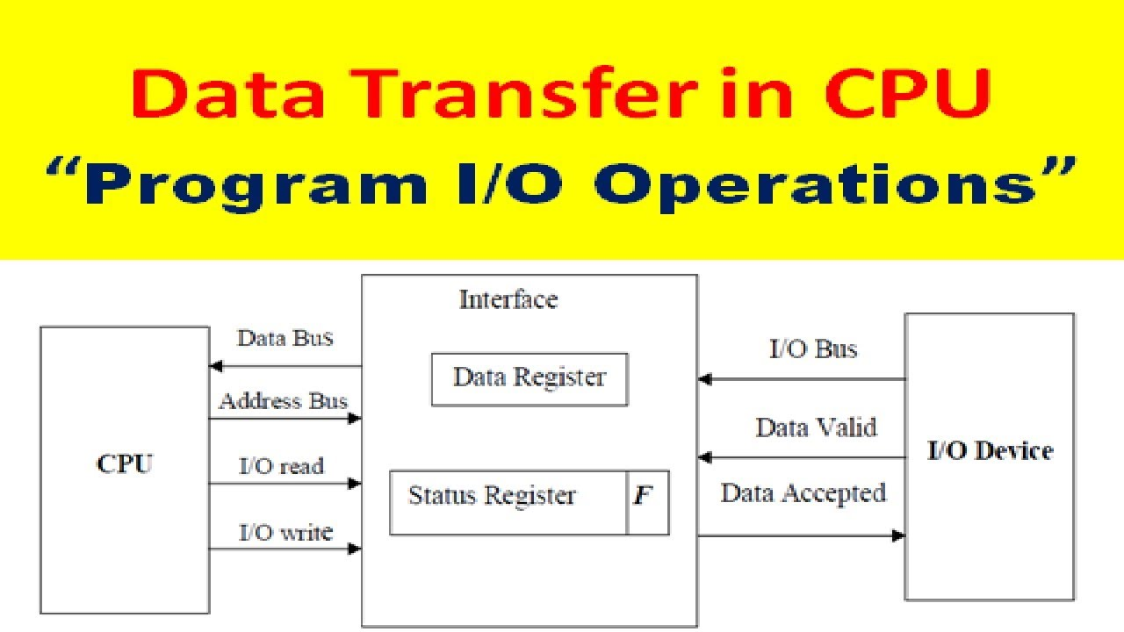
Programmed I/O
Operation:-
Address the Device.
Check its status.
IF ready
perform operation else
check another device

Slide 5
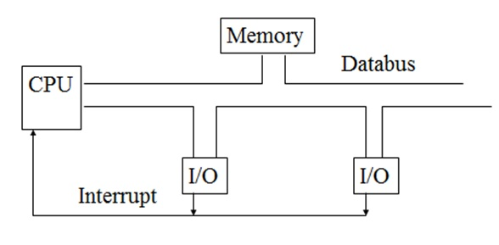
Interrupt driven I/O
Operation:-
Device interrupt’s CPU
CPU acknowledge the I/O device.
CPU perform operation

Slide 6
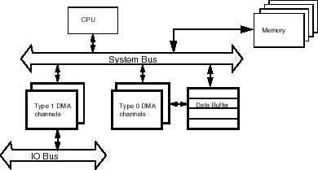
Direct Memory Access
Operation:-
CPU call DMA for operation
It will allow the device to access memory directly.

Slide 7
DMA Data Transfer
It is data transfer technique directly between memory and I/O without CPU intervention.
Under the supervision of extra hardware called DMA controller .
Fastest type of data transfer technique among this parallel group.

Slide 8
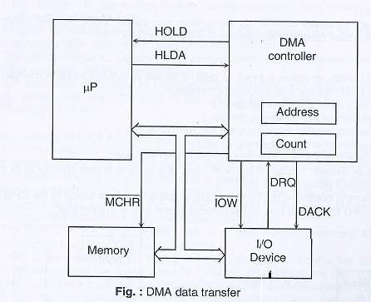
DMA Data Transfer

Slide 9
1. The I/O device asserts DRQ signal.
2. DMA controller send HOLD signal to microprocessor
3. microprocessor Send HLDA to DMA Controller& DMA
Takes charge of system bus.
4. DMA give DMA ACK(back) signal to I/O devices
5.now, DMA controller places memory address on address bus and data bytes from memory transfer to I/O .
6.DMA Controller updates memory address register and word
count register.
7. when internal count = 0 then DMA Controller sets HOLD=0
8. now processor regain the charge od the system bus which
continues the normal operation.
DMA Data Transfer
Process

Slide 10


